Slide 1
Employee Attrition Analysis
Created by HARISH PALANISAMY

Slide 2
Overview
Dataset Link: https://github.com/harishp-17/CODING-SAMURAI-INTERNSHIP-TASK.git

Slide 3
Analysis

Slide 4
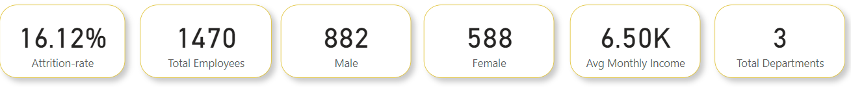
Analysis:
The overall attrition rate in the company is 16%, indicating a significant turnover of employees.The store generated 10 CORE in revenue.
Total Emplyees are 1000 in 512 are Males and 488 are Females.
The average monthly income is 90000K.
1000
512
488
90000
6

Slide 5
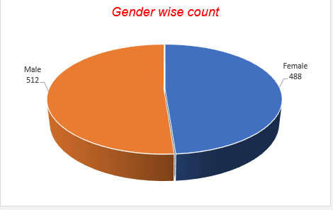
Attrition By Gender Status:
Gender status significantly affects attrition rates. The Most of of workers are Mens 512 and womwns are 488.

Slide 6
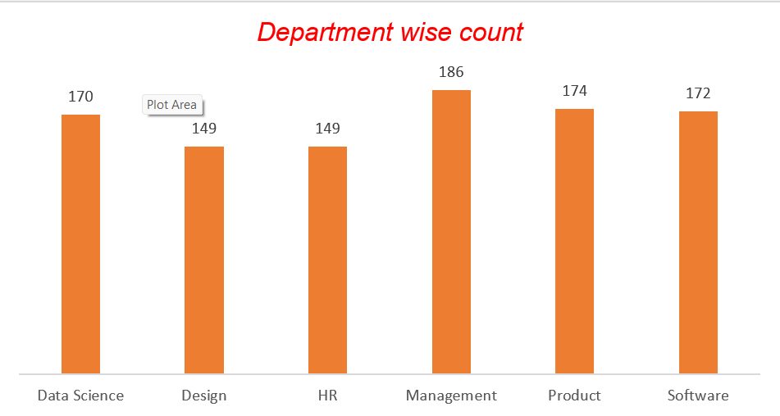
Attrition By Department:
Employees in the Company Most of Members work in Management Department and totally 6 department Handled in the company

Slide 7
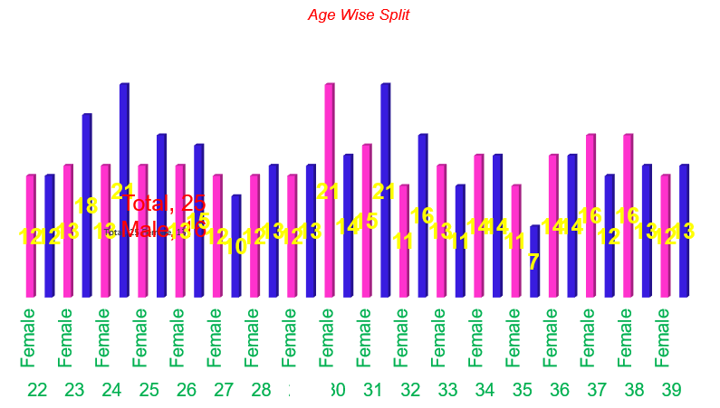
Attrition By Age:
The average age of employees is, 24 to 34 and the pink reperesent women and Blue reperesent men.See the graph the majority is men workers is high.

Slide 8
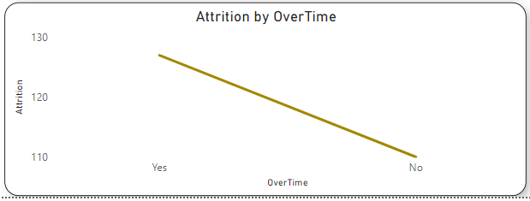
Attrition By Overtime:
Employees who work more overtime are more likely to depart from the company, suggesting that excessive work hours may contribute to attrition.

Slide 9
Attrition By Job Role:
The Management job role has the highest rate of job satisfaction and the highest income, even though it has the highest attrition after the Data Science job role.

Slide 10
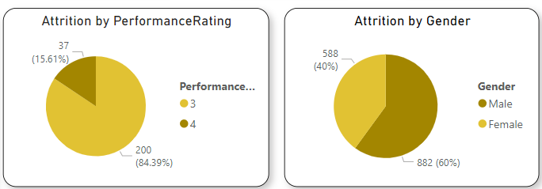
Attrition By Performance and Gender:
Males are more likely to depart from the company compared to females, suggesting a potential gender-based attrition pattern.
Employees with lower monthly incomes and high-performance rates are showing higher attrition rates, potentially indicating a need to revisit compensation structures and career growth opportunities.
488
512

Slide 11
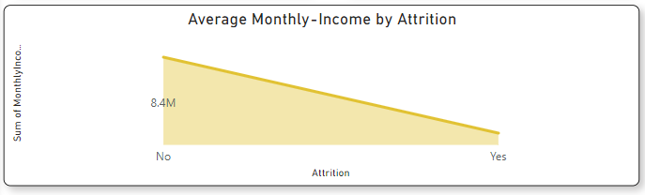
Avg Monthly income And Attrition:
Those who have less monthly income and high performing rates are showing more attrition rates

Slide 12
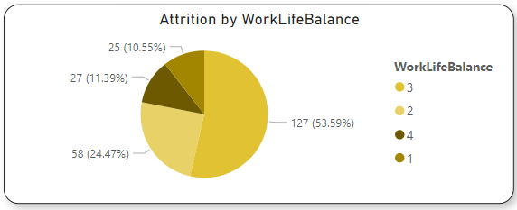
Attrition By Work Life Balance:
Employees who do not have a healthy work-life balance are more likely to leave, emphasizing the importance of promoting work-life equilibrium.

Slide 13
Strategies For Employee Retention:
Gender-Inclusive Policies: Implement gender-inclusive policies and programs to address the higher attrition rate among males, promoting equal opportunities and support.
Age-Specific Programs: Tailor retention strategies for younger employees, including career development opportunities and mentorship programs to engage and retain them.
Departmental Interventions: Investigate the reasons behind high attrition in the sales and development departments, and address issues related to workload, recognition, and career progression.
Overtime Management: Implement policies and systems to manage and reduce excessive overtime, ensuring employees can maintain a healthy work-life balance.

Slide 14
Strategies For Employee Retention:
Compensation and Career Growth: Review compensation structures and provide a clear path for career growth to retain high-performing employees with lower incomes.
Improve Work Environment: Focus on improving the work environment and culture to enhance job satisfaction and overall employee well-being.
New Hire Retention: Develop onboarding programs and mentorship initiatives to engage and retain employees with less tenure.
Work-Life Balance Support: Promote work-life balance through flexible scheduling, remote work options, and wellness programs to reduce attrition among employees struggling with work-life balance.

